Slide 1
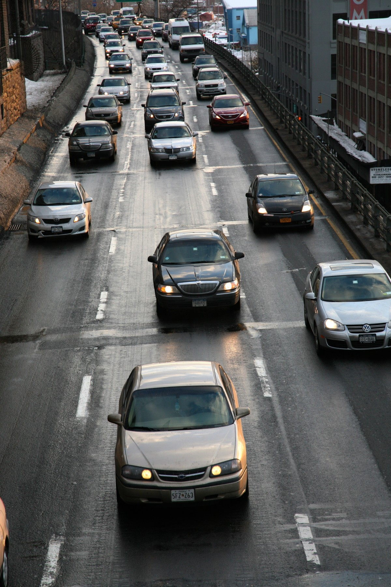
Accident Prediction and Prevention
m-Indicator AI\ML Hackathon 2024
BY Team AI Jats

Slide 2
Approximately 1.19 million people die each year as a result of road traffic crashes. Road traffic injuries are the leading cause of death for children and young adults aged 5–29 years.
- statistics by WHO

Slide 3

Solution
A System that predicts when and where the highest probability and severity of Accidents are going to take place and then efficiently deploy police force in those areas.

Slide 4
How will it work?
Gathering a large global dataset
Making a high-level model which predicts accidents and their severity.
For each district, training the pretrained model with local data.
For each district, create a dataset of high traffic local roads and highways.
Automatically run prediction on these areas by fetching future data using weather and other APIs periodically.
According to Police force constraints and predicted severity index, outputting optimized use of police force using pulp for this non-linear problem.

Slide 5
Impact
Decrease in Accidents due to 88% recall for high severity.
Proper utilization of Police force.
Better Understanding of what causes accidents.
Better Understanding for proper legislation in road safety.

Slide 6
Challenges
Data availability for India setting
Data availability for local setting
Difference between factors effecting accidents in India and abroad.
Proper weather and other APIs for remote locations
Formulating relation of non-linear impact of police force on accidents.
Proper deployment for ease of use.

Slide 7

Thank You

